Slide 1


Oracle Sql for developers

Slide 2
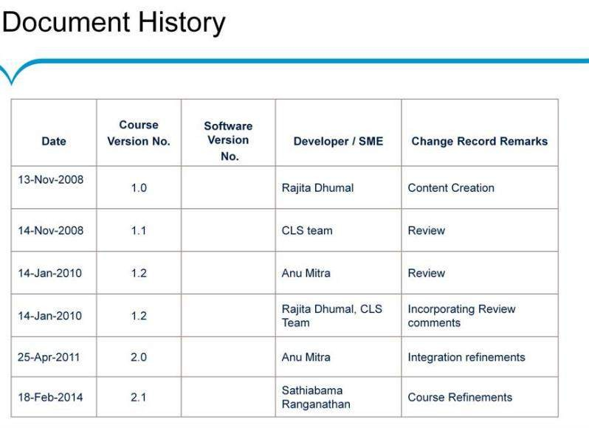
Introduction to Programming
Slide 2

Slide 3

Course Goals and Non-Goals
Slide 3

Slide 4
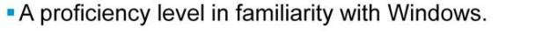
Pre-requisites
Slide 4

Slide 5

Intended Audience
Slide 5

Slide 6
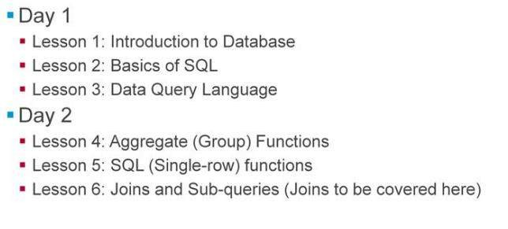
Day-Wise Schedule
Slide 6

Slide 7
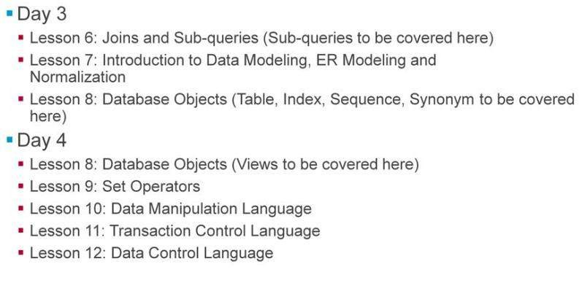
Day-Wise Schedule
Slide 7

Slide 8
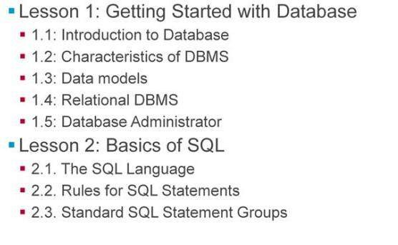
Table of Contents
Slide 8

Slide 9
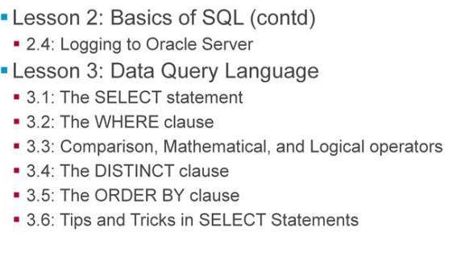
Table of Contents
Slide 9

Slide 10
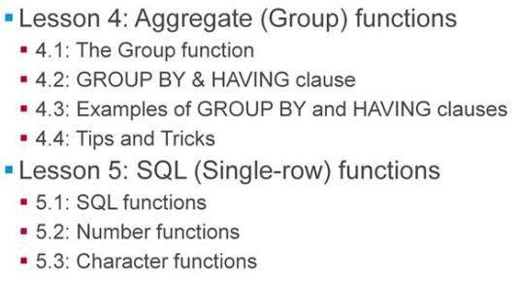
Table of Contents
Slide 10

Slide 11
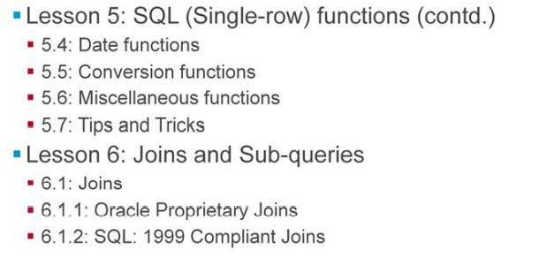
Table of Contents
Slide 11

Slide 12
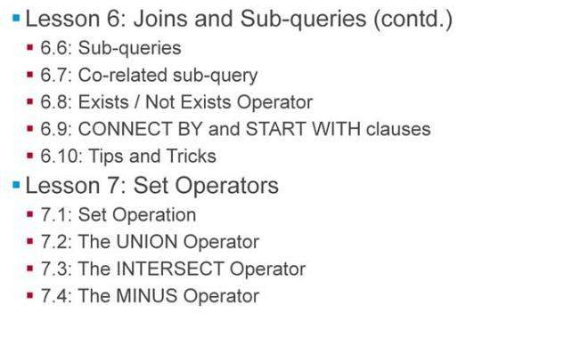
Table of Contents
Slide 12

Slide 13
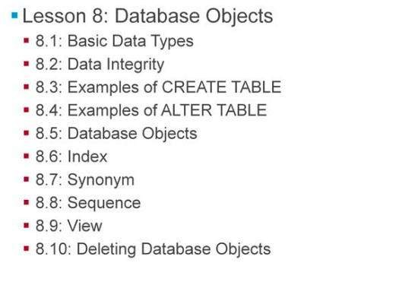
Table of Contents
Slide 13

Slide 14
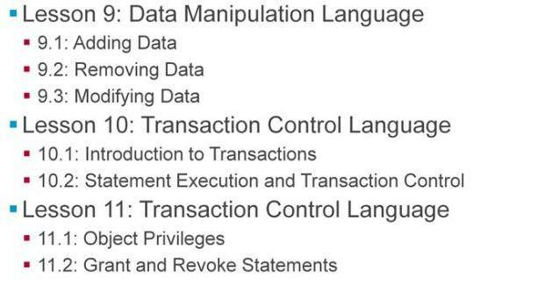
Table of Contents
Slide 14

Slide 15

References
Slide 15

Slide 16

Next Step Courses(if aplicable)
Slide 16

Slide 17
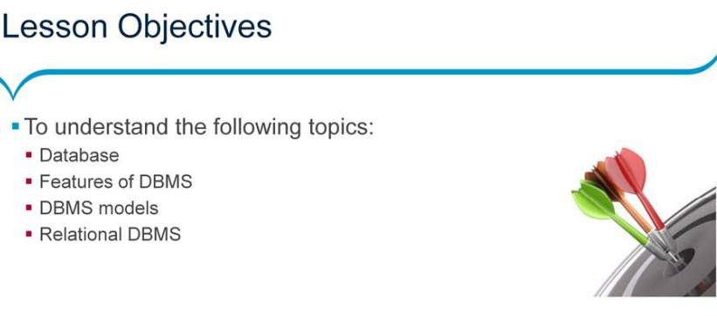
Lesson 01: Getting Started with Database
Slide 17

Slide 18
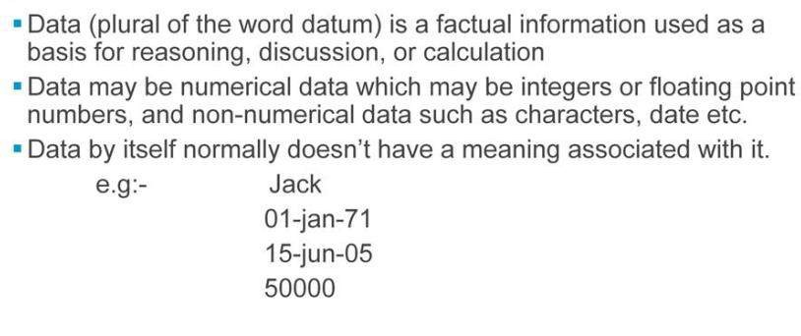
What is Data?
Slide 18

Slide 19
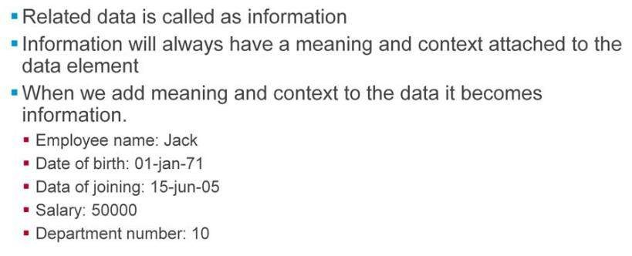
What is information?
Slide 19

Slide 20
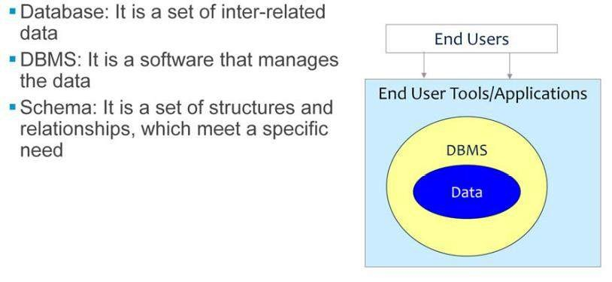
Defining Database, Dbms and Schema
Slide 20

Slide 21
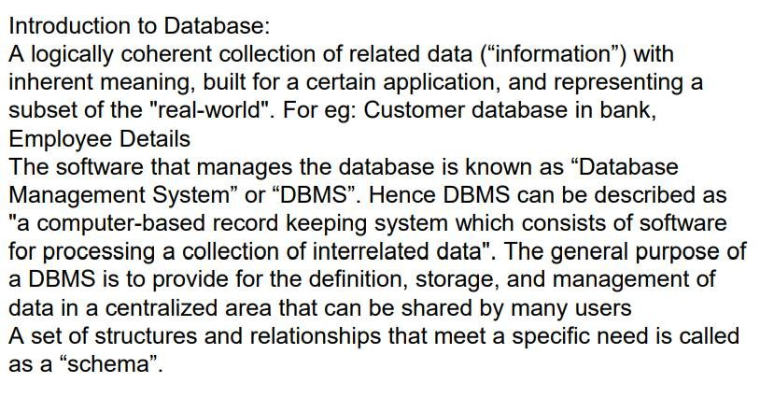
Defining Database, Dbms and Schema
Slide 21

Slide 22
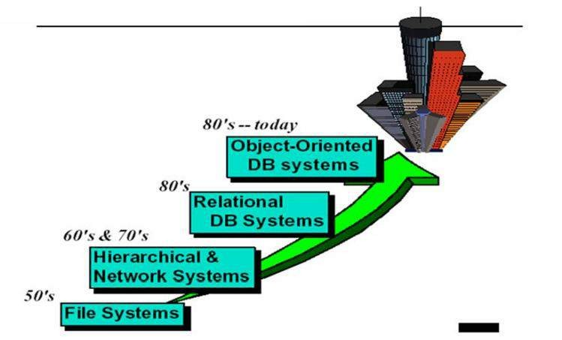
Evaluation of Databases
Slide 22

Slide 23
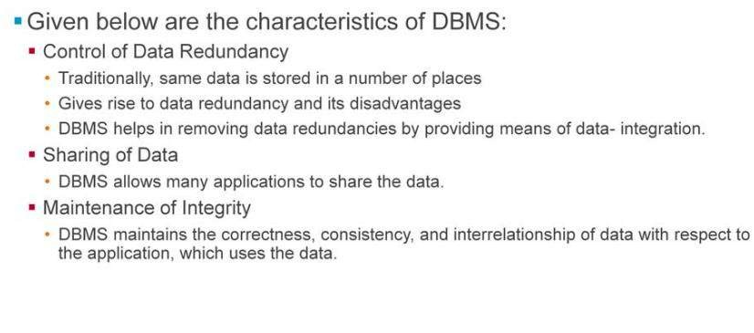
Characteristics of DBMS
Slide 23

Slide 24
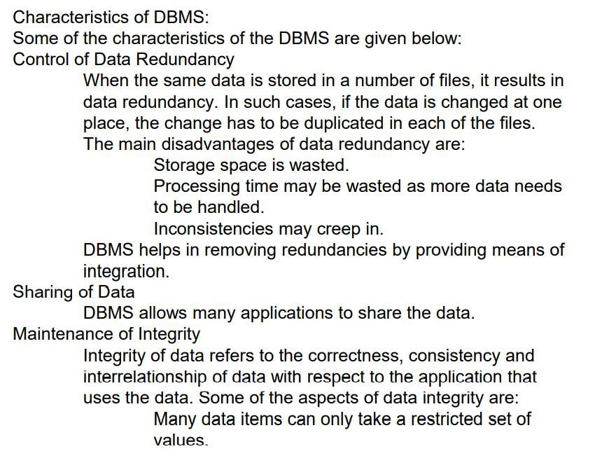
Characteristics of DBMS
Slide 24

Slide 25
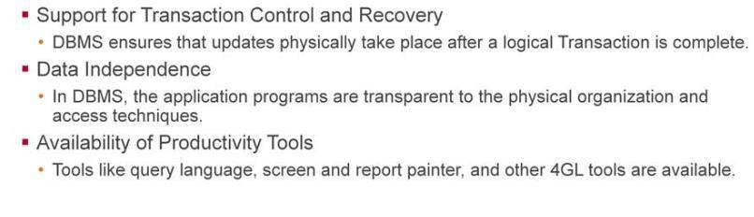
Characteristics of DBMS
Slide 25

Slide 26
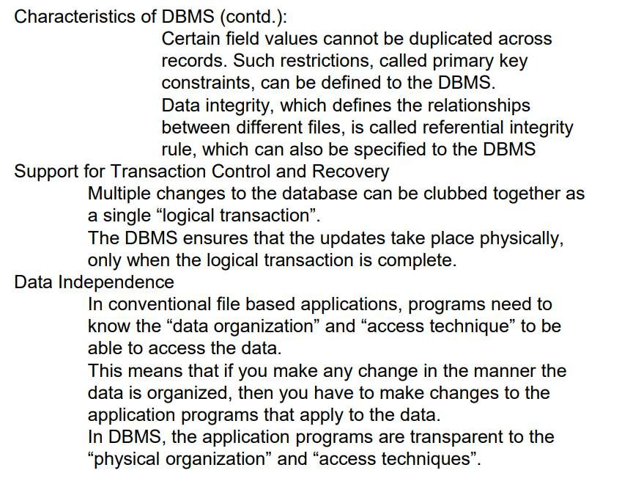
Characteristics of DBMS
Slide 26

Slide 27
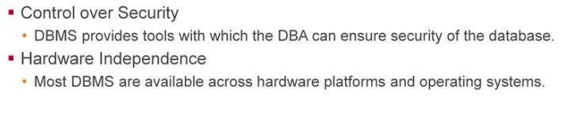
Characteristics of DBMS
Slide 27

Slide 28
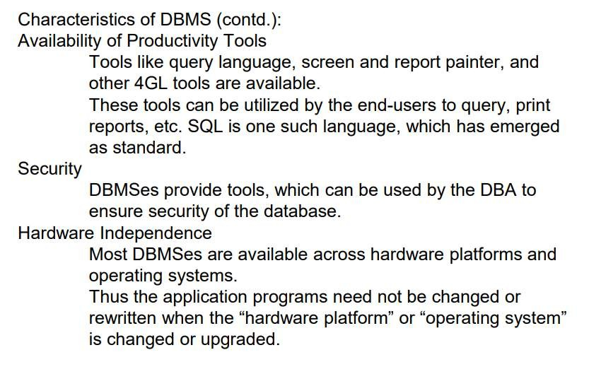
Characteristics of DBMS
Slide 28

Slide 29
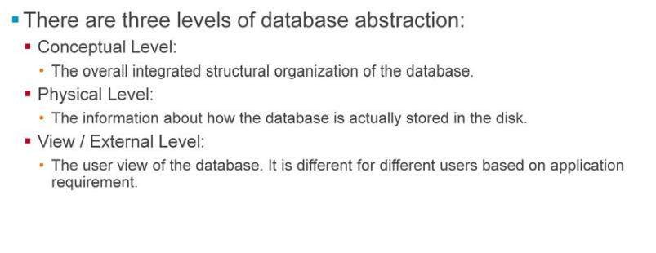
Levels of Abstraction
Slide 29

Slide 30
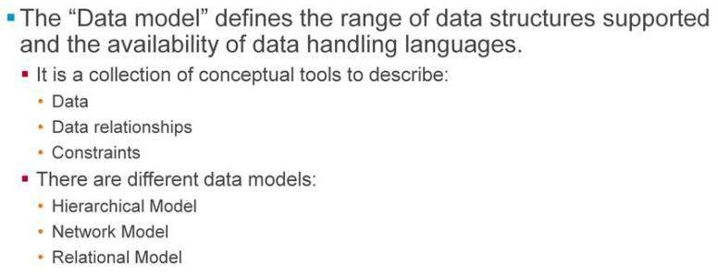
What is Data Model?
Slide 30

Slide 31
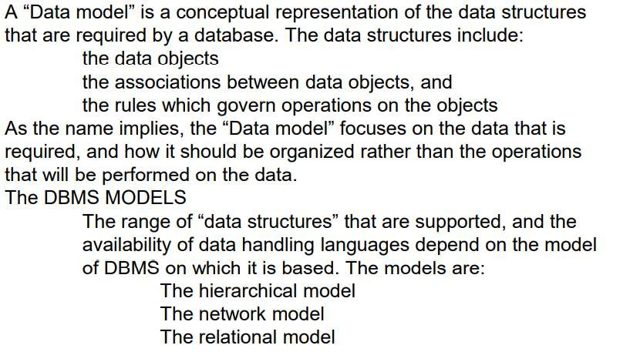
What is Data Model?
Slide 31

Slide 32
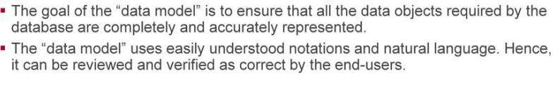
Why is Data Modelling Important?
Slide 32

Slide 33
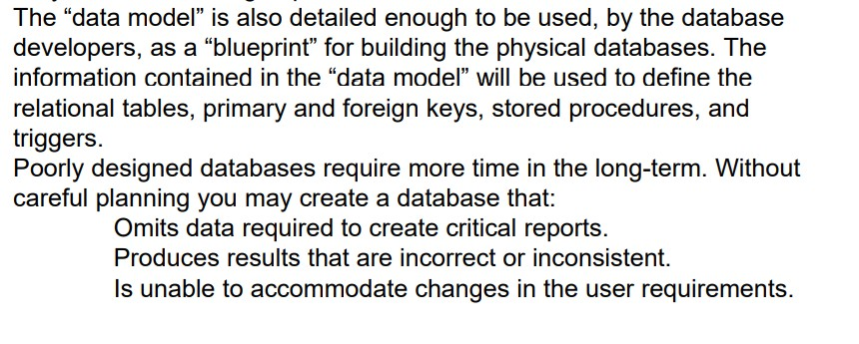
Why is Data Modelling Important?
Slide 33

Slide 34
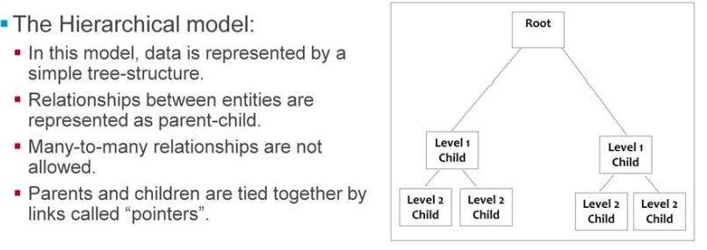
Hierarchical Model
Slide 34

Slide 35
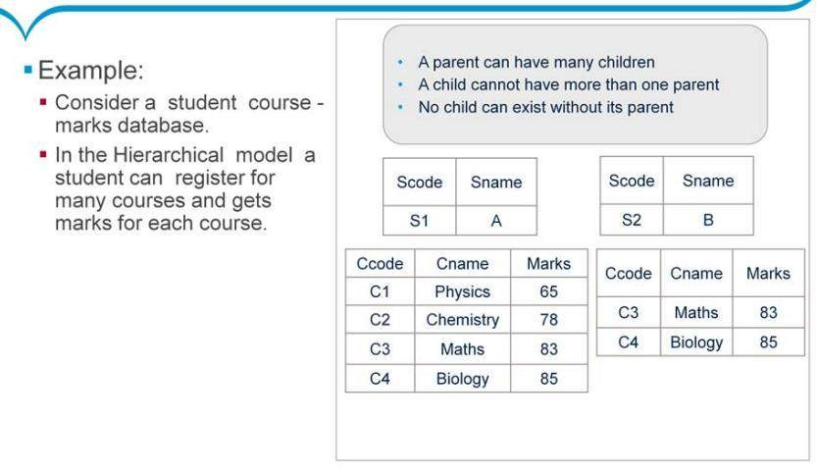
Hierarchical Model - Example
Slide 35

Slide 36
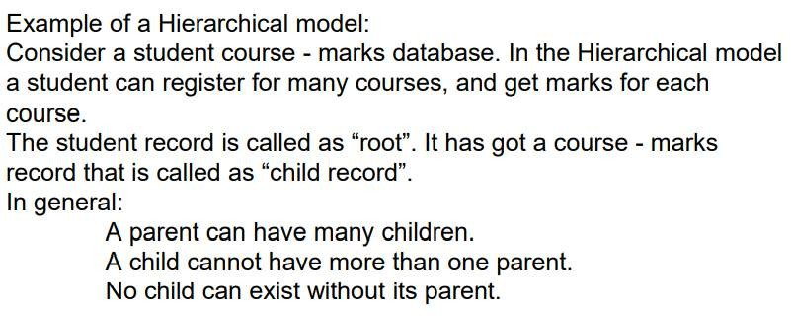
Hierarchical Model - Example
Slide 36

Slide 37
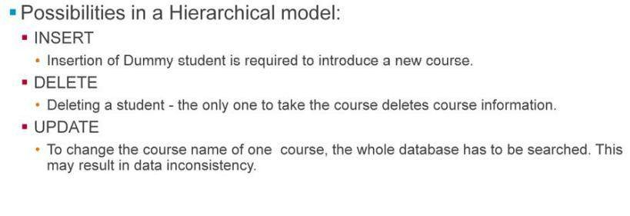
Hierarchical Model - Possibilities
Slide 37

Slide 38
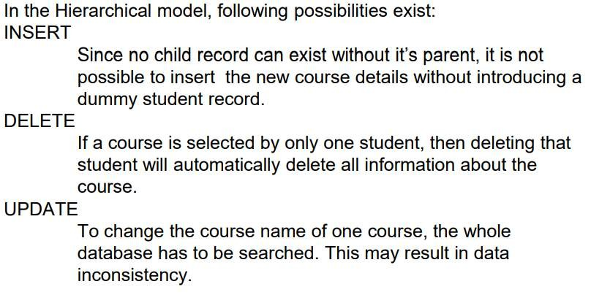
Hierarchical Model - Possibilities
Slide 38

Slide 39
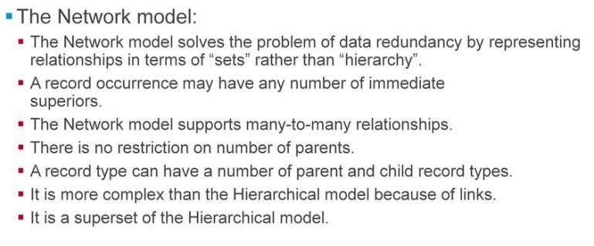
Network Model
Slide 39

Slide 40
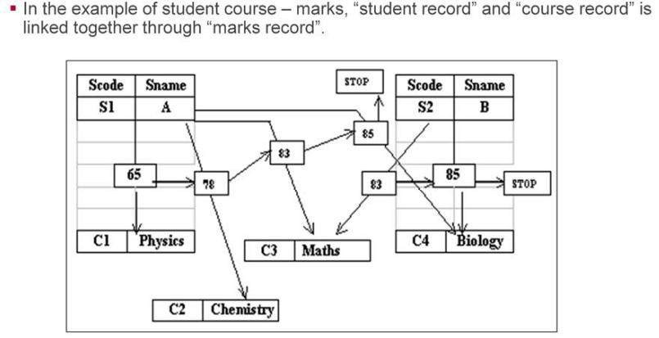
Network Model - Example
Slide 40

Slide 41
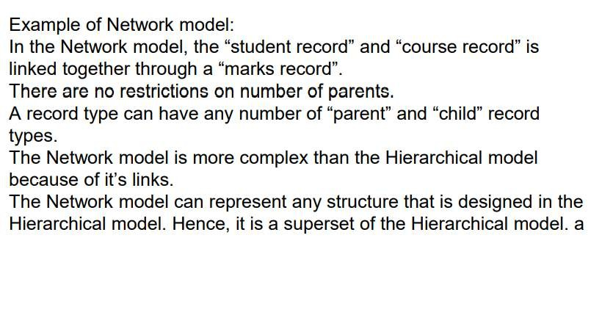
Network Model - Example
Slide 41

Slide 42
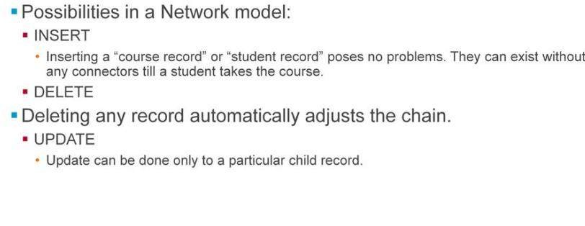
Network Model - Possibilities
Slide 42

Slide 43
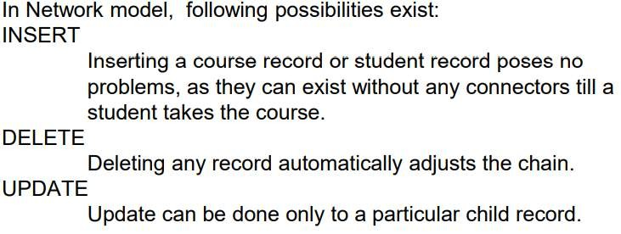
Network Model - Possibilities
Slide 43

Slide 44
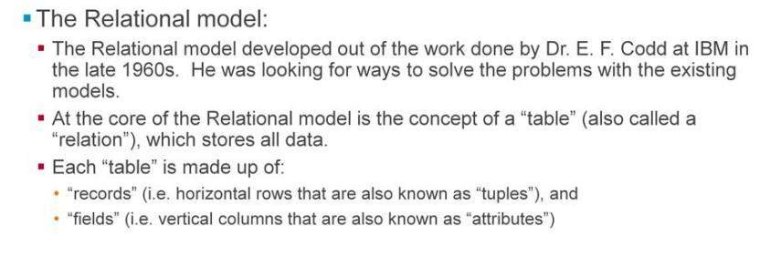
Relational Model
Slide 44

Slide 45
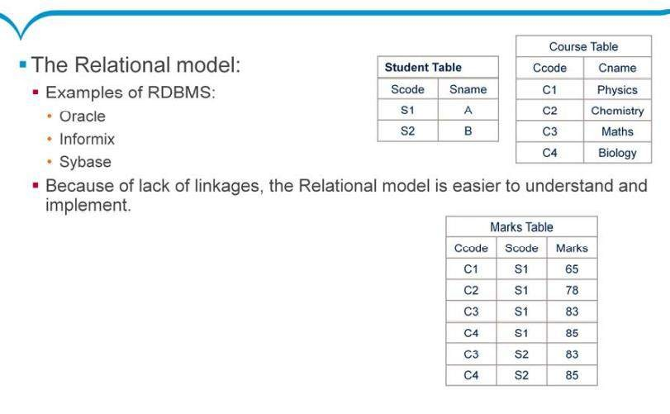
Relational Model
Slide 45

Slide 46
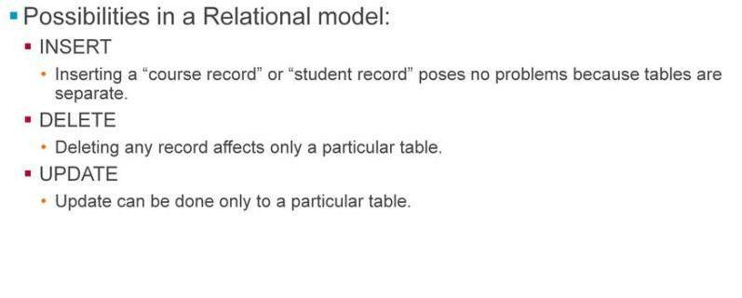
Relational Model - Possibilities
Slide 46

Slide 47
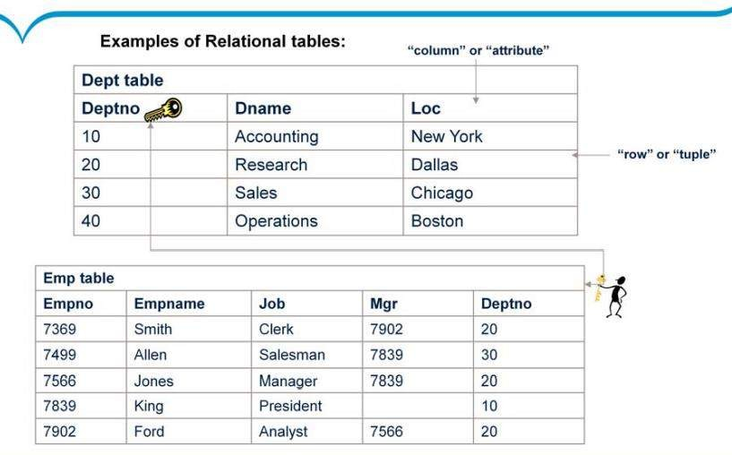
Relational Tables
Slide 47

Slide 48
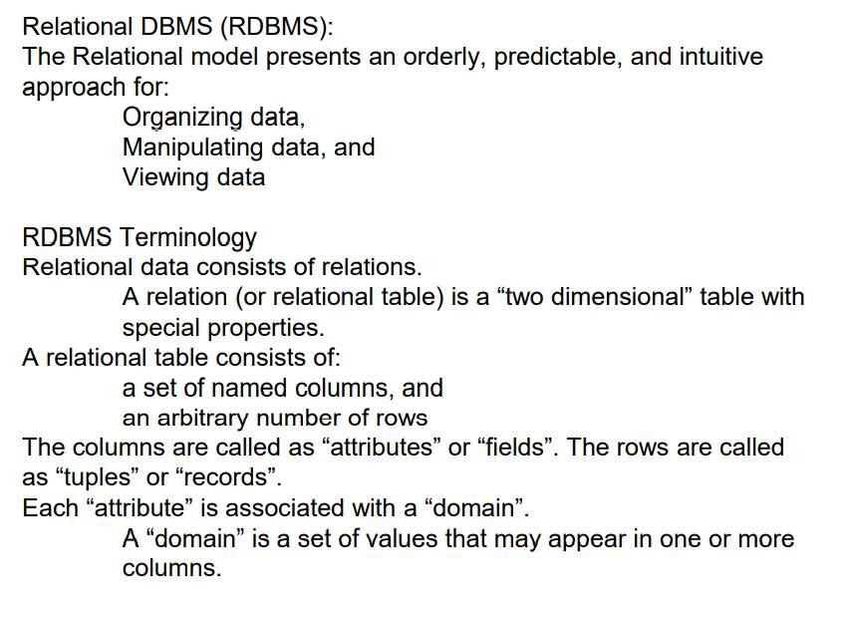
Relational Tables
Slide 48

Slide 49
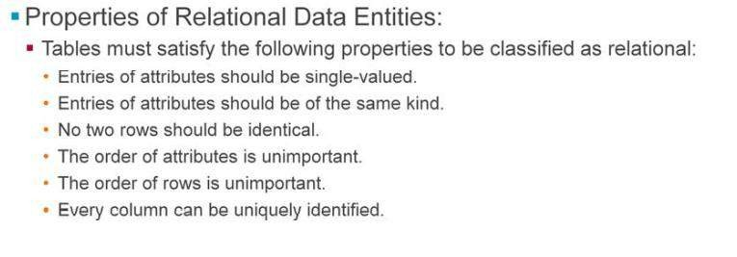
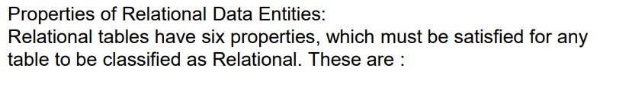
Relational Tables - Properties
Slide 49

Slide 50
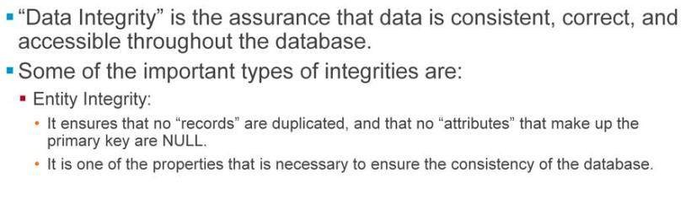
Data Integrity
Slide 50

Slide 51
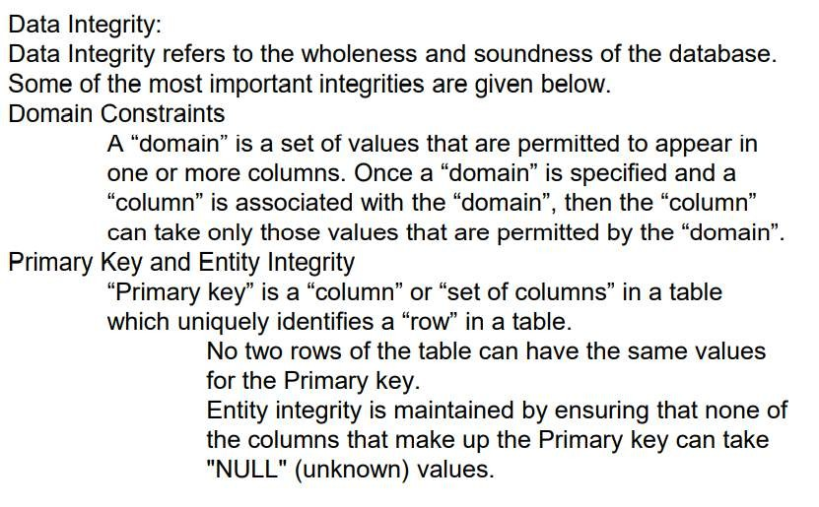
Data Integrity
Slide 51

Slide 52
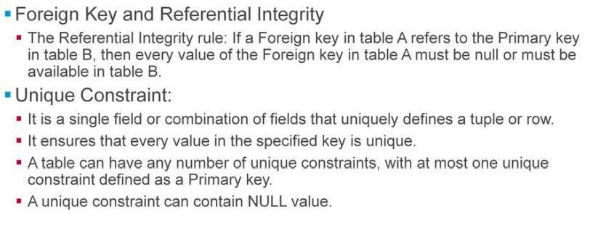
Data Integrity
Slide 52

Slide 53
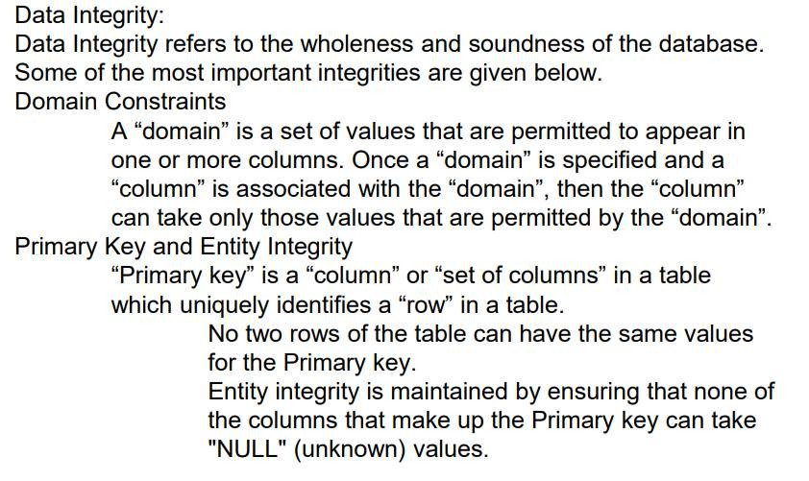
Data Integrity
Slide 53

Slide 54
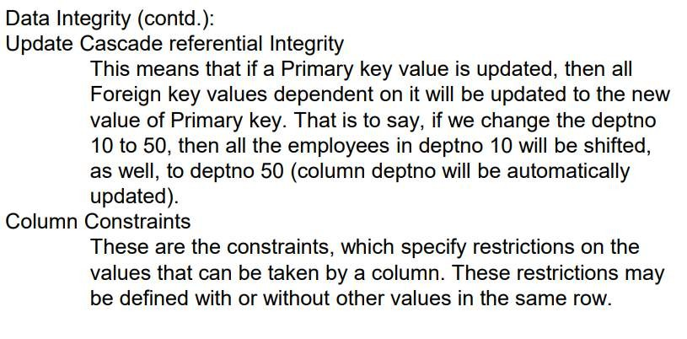
Data Integrity
Slide 54

Slide 55

Data Integrity
Slide 55

Slide 56

Database Administrator
Slide 56

Slide 57

Database Administrator
Slide 57

Slide 58

Summary
Slide 58

Slide 59

Review Question
Slide 59

Slide 60

Review Question
Slide 60

Slide 61

Lesson 2: Basics of SQL
Slide 61

Slide 62

What is SQL?
Slide 62

Slide 63

What is SQL?
Slide 63

Slide 64

What can SQL Do?
Slide 64

Slide 65

What can SQL Do?
Slide 65

Slide 66

Rules for SQL statements
Slide 66

Slide 67

Standard SQL statement Groups
Slide 67

Slide 68

Standard SQL statement Groups
Slide 68

Slide 69

SQL * PLUS Tool
Slide 69

Slide 70

SQL PLUS Tool
Slide 70

Slide 71

Logging to Oracle Server using iSQLPlus
Slide 71

Slide 72

Logging to Oracle Server using iSQLPlus
Slide 72

Slide 73

Logging to Oracle Server using iSQLPlus
Slide 73

Slide 74

Logging to Oracle Server using iSQLPlus
Slide 74

Slide 75

Summary
Slide 75

Slide 76

Review Question
Slide 76

Slide 77

Review Question
Slide 77

Slide 78

Lesson 3: Data Query language
Slide 1

Slide 79

The Select Statement And Syntax
The SELECT Statement:
The SELECT statement is used to select data from a table. The tabular result is stored in a result table (called the result-set). The statement begins with the SELECT keyword. The basic SELECT statement has three clauses:
SELECT FROM WHERE
The SELECT clause specifies the table columns that are retrieved. The FROM clause specifies the tables accessed. The WHERE clause specifies which table rows are used. The WHERE clause is optional; if missing, all table rows are used. Note: Each clause is evaluated on the result set of a previous clause. The final result of the query will be always a “result table”. Only FROM clause is essential. The clauses WHERE, GROUP BY, HAVING, ORDER BY, UNION are optional. All the examples that follow are based on EMP and DEPT tables that are already available.
Slide 2

Slide 80

Selecting Columns
Slide 3

Slide 81

The Where Clause
The WHERE Clause:
The WHERE clause is used to perform “selective retrieval” of rows. It follows the FROM clause, and specifies the search condition. The result of the WHERE clause is the row or rows retrieved from the Tables, which meet the search condition. The clause is of the form:
Comparison Predicates:
The Comparison Predicates specify the comparison of two values. It is of the form:
< Expression> < operator > < Expression> < Expression> The operators used are shown on
the next slide:
Slide 4

Slide 82

Character Strings and Dates
Oracle Database store dates in an internal numeric format, representing the century, year, month,
day, hours, minutes, and seconds. The date datatype is covered in detail later
Slide 5

Slide 83

Mathematical, Comparison & Logical Operators
Operators:
Operators are used in “expressions” or “conditional statements”. They show equality, inequality, or a combination of both. Operators are of three types: mathematical logical range (comparison) These operators are mainly used in the WHERE clause, HAVING clause in order to filter the data to be selected. Mathematical operators: These operators add, subtract, multiply, divide, and compare equality of numbers and strings. They are +, -, *, / Comparison Operators: These operators are used to compare the column data with specific values in a condition. “Comparison Operators” are also used along with the “SELECT statement” to filter data based on specific conditions. The table in the slide describes each Comparison operator. Comparison operators indicate how the data should relate to the given search value. Logical Operators: There are three Logical Operators namely AND, OR and NOT. These operators compare two conditions at a time to determine whether a row can be selected for the output or not. When retrieving data by using a SELECT statement, you can use logical operators in the WHERE clause. This allows you to combine more than one condition.
Slide 6

Slide 84


Other Comparison Operators
Slide 7

Slide 85

Between…And Operator
Slide 8

Slide 86

IN Operator
IN predicate:
It is of the form:
<Expression>IN<List>
<Expression>IN<Subquery> The data types should match.
Slide 9

Slide 87

IN Operator
IN predicate:
It is of the form:
<Expression> IN<LIST>
<Expression>IN<Subquery> The data types should match.
Slide 10

Slide 88

LIKE OPERATOR
LIKE predicate:
It is of the form:
<COLUMN>LIKE < PATTERN>
The pattern contains a search string along with other special characters % and _. The % character represents a string of any length where as _ (underscore) represents exactly one character. A pattern %XYZ% means search has to be made for string XYZ in any position. A pattern '_XYZ%' means search has to be made for
string XYZ in position 2 to 4. To search for characters % and _ in the string itself we have to use an “escape” character. For example: To search for string NOT_APP in column status, we have to use the form Status like 'NOT\_APP' ESCAPE '\' The use of \ as escape character is purely arbitrary.
Slide 11

Slide 89




Logical Operators
The AND operator displays a record if both the first condition and the second condition is true.
One More Example:
Combining Predicates by using Logical Operators: The predicates can be combined by using logical operators like AND, OR, NOT. The evaluation proceeds from left to right and order of evaluation is: * Enclosed in parenthesis
AND OR
Slide 12
Course Url

Slide 90

Using AND or OR Clause
The OR operator displays a record if either the first condition or the second condition is true. You can also combine AND and OR as shown in above example. (use parenthesis to form complex expressions).
Slide 13

Slide 91

Using NOT Clause
Note: NOT is a negation operator
Slide 14

Slide 92

Treatment of Null Values
NULL predicate: The NULL predicate specifies a test for NULL values. The form for NULL predicate is: < COLUMN SPECIFICATION > IS NULL. < COLUMN SPECIFICATION > IS NOT
NULL. < COLUMN SPECIFICATION > IS NULL returns TRUE only when column has NULL values. = NULL cannot be used to compare null values.
Slide 15

Slide 93

Operator Precedence
Operator Precedence: When a complex expression has multiple operators, the operator precedence (or order of execution of operators) determines the sequence in which the operations are performed. The order of execution can significantly affect the resulting value. The operators have the precedence levels as shown in the table given in the slide. An operator on higher levels is evaluated before an operator on lower level.
Slide 16

Slide 94

The DISTINCT Clause
The DISTINCT clause: In the examples discussed so far, some of the values have been repeated. However, by default, all values are retrieved. If you wish to remove duplicate values, then use the query as shown in the slide above
Slide 17

Slide 95



Retrival Of Constant Values By Dual Table
A “dual” is a table, which is created by Oracle along with the data dictionary. It consists of exactly one column, whose name is dummy, and one record. The value of that record is X.
The owner of dual is SYS. However, “dual” can be accessed by every user. As “dual” contains exactly one row (unless someone has fiddled with it), it is guaranteed to return exactly one row in SELECT statements. Therefore, dual
For example, you can use it for math
Slide 18

Slide 96

The ORDER BY Clause
The Order By Clause:
A query with its various clauses (FROM, WHERE, GROUP BY, HAVING) determines the rows to be selected and
the columns. The order of rows is not fixed unless an ORDER BY clause is given.
An ORDER BY clause is of the form
The columns to be used for ordering are specified by using the “column names” or by specifying the “serial number” of the column in the SELECT list.
The sort is done on the column in “ascending” or “descending” order. By default the ordering of data
is “ascending” order
Slide 19

Slide 97



Sorting Data
The query on the slide sorts the data on both the columns in ascending order which is default. But you could also sort the data in different order for the columns. For Example in the query given below the data is sorted in ascending order on student_code and dept_code is sorted in descending order
Slide 20

Slide 98


Quick Guidelines
Tips and Tricks in SELECT Statements:
It is necessary to always include a WHERE clause in your SELECT statement to narrow the number of rows returned. In some case you may want to return all rows. Then not using a WHERE clause is appropriate in this case. However, if you don’t need all the rows to be returned, use a WHERE clause to limit the number of rows returned. Another negative aspect of a table scan is that it will tend to flush out data pages from the cache with useless data. This reduces ability of the Oracle to reuse useful data in the cache, which increases disk I/O and decreases performance.
Slide 21

Slide 99

Quick Guidelines
Tips and Tricks in SELECT Statements (contd.):
Some developers, as a habit, add the DISTINCT clause to each of their SELECT statements, even when it is
not required. This is a bad habit that should be stopped.
Slide 22

Slide 100

Quick Guidelines
Tips and Tricks in SELECT Statements (contd.):
Use simple operands Some operators tend to produced speedy results than other operators. Of course, you may not have choice of using an operator in your WHERE clauses, but sometimes you do have a choice. Using simpler operands, and exact numbers, provides the best overall performance. If a WHERE clause includes multiple expressions, there is generally no performance benefit gained by ordering the various expressions in any particular order.
This is because the Query Optimizer does this for you, saving you the effort. There are a few
exceptions to this, which are discussed further in the lesson. contd.
Slide 23

Slide 101


Tips And Tricks In Select Statement Contd..
Don’t include code that does not do anything
This may sound obvious. However, this scenario is seen in some off-the-shelf applications. For example, you may see code which is given below:
When this query is run, no rows will be returned. It is just wasting SQL Server resources.
By default, some developers routinely include code, which is similar to the one given above, in their WHERE clauses when they make string comparisons.
For example:
Any use of text functions in a WHERE clause decreases performance.
If your database has been configured to be case-sensitive, then using text functions in the WHERE clause does decrease performance. However, in such a case, use the technique described below, along with appropriate indexes on the column in question:
Slide 24

Slide 102

Quick Guidelines
Tips and Tricks in SELECT Statements (contd.):
If you use a leading character in your LIKE clause, then the Query Optimizer has the ability to potentially use an Index
to perform the query. Thus speeding performance and reducing the load on SQL engine. However, if the leading
character in a LIKE clause is a “wildcard”, then the Query Optimizer will not be able to use an Index. Here a table scan must be run, thus reducing performance and taking more time. The more leading characters you use in the LIKE clause, it is more likely that the Query Optimizer will find and use a suitable Index.
Slide 25

Slide 103

Quick Guidelines
Tips and Tricks in SELECT Statements (contd.):
Assuming there is a useful Index on customer number, the Query Optimizer can locate a range of numbers much faster by using BETWEEN clause. This is much faster than it can find a series of numbers by using the IN clause (which is really just another form of the OR clause). Using Efficient Non-index WHERE clause sequencing: Oracle evaluates un-indexed equations, linked by the AND verb in a bottom-up fashion. This means that the first clause (last in the AND list) is evaluated, and if it is found TRUE, then the second clause is tested. Always try to position the most expensive clause first in the WHERE clause sequencing. Oracle evaluates un-indexed equations, linked by the OR verb in a top-down fashion. This means that the first clause (first in the OR list) is evaluated, and if it is found FALSE, then the second clause is tested. Always try to position the most expensive OR clause last in the WHERE clause sequencing.
Slide 26

Slide 104

Quick Guidelines
Tips and Tricks in SELECT Statements (contd.): Don’t use ORDER BY in your SELECT statements unless you really need to: The ORDER BY clause adds a lot of extra overhead. For example: Sometimes it may be more efficient to sort the data at the client than at the server. In other cases, the client does not even need sorted data to achieve its goal. The key here is to remember that you should not automatically sort data, unless you know it is necessary. Whenever SQL Server has to perform a sorting operation, additional resources have to be used to perform this task. Sorting often occurs when any of the following Transact-SQL statements are executed:
ORDER BY GROUP BY SELECT DISTINCT UNION
CREATE INDEX ,generally not as critical as happens much less often) In many cases, these commands cannot be avoided. On the other hand, there are few ways in which sorting overhead can be reduced, like: Keep the number of rows to be sorted to a minimum. Do this by only returning those rows that absolutely need to be sorted. Keep the number of columns to be sorted to the minimum. In other words, do not sort more columns than required. Keep the width (physical size) of the columns to be sorted to a minimum. Sort column with number datatypes instead of character datatypes
Slide 27

Slide 105

Summary
Slide 28

Slide 106

Review - Questions
Slide 29

Slide 107

Review - Questions
Slide 30

Slide 108

Lesson 4: Aggregate(GROUP) Functions
Slide 1

Slide 109

Types of SQL Functions
Functions:
Functions can be used to manipulate data values in a variety of ways. Functions help in making the basic query block more powerful. Functions may be used to perform calculations on data, alter data formats for display, convert data types, etc. Functions are similar to operators in that they manipulate data items and return a result. Functions differ from operators in the format in which they appear with their arguments. This format allows them to operate on zero, one, two, or more arguments: function(argument, argument, ...)
Slide 2

Slide 110
Types of SQL Functions
→There are two types of functions:
SQL functions and User-defined functions. SQL functions: SQL functions are built into most DBMS and are available for use in various appropriate SQL statements. SQL functions are further categorized as: Single- Row functions: Single-row functions return a single result row for every row of a queried Table or View.
For Aggregate functions: Aggregate functions return a single row based on groups of rows, rather than on
single rows. For example: MAX, MIN, COUNT, etc.
User-defined functions: You can write user-defined functions in PL/SQL or Java to provide functionality that is not available in SQL or SQL functions. User-defined functions can appear in a SQL statement wherever SQL functions can appear, that is, wherever an expression can occur.
For example: User-defined functions can be used in the following: The select list of a SELECT statement The condition of a WHERE clause CONNECT BY, START WITH, ORDER BY, and GROUP BY clauses The VALUES clause of an INSERT statement The SET clause of an UPDATE statement example: ABS, ROUND etc.
Slide 3

Slide 111

The Group Functions
Aggregate (Group) Functions:
SQL provides a set of “built-in” functions for producing a single value for an entire group. These functions are called as “Set functions” or “Aggregate (Group) functions”. These functions can work on a “normal result table” or a
“grouped result table”. If the result is not grouped, then the aggregate will be
taken for the whole result table.
Slide 4

Slide 112

Syntax GROUP BY & HAVING Clause
Slide 5

Slide 113

Listing of Group Functions
Aggregate (Group) Functions supported by SQL:
All the above functions operate on a number of rows (for example, an entire table), and are therefore known as “Group (or Aggregate) functions”. A Group function can be used on a subset of the rows in a table by using the WHERE clause. The Aggregate functions ignore NULL values in the column. To include NULL values, NVL function can be used with Aggregate functions.
Note : Count(*): Returns the number of rows in the table, including duplicates and those
with NULLs. Count(): Returns the number of rows where expression is NOT NULL.
Slide 6

Slide 114



Aggregate(Group)Functions Supported By SQL
→SUM(COL_NAME | EXPRESSION)
SUM returns the total of values present in a particular “column” or a “number of columns” that are linked together in the expression. All the columns, which form the argument to SUM, must be numeric only.
To find the sum of one subject for all students following query is used:
To find the yearly compensation of staff from department 20, the following query is used:
-> AVG(COL_NAME | EXPRESSION)
AVG is similar to SUM. AVG returns the average of a NUMBER of values. The restrictions, which apply on SUM
also, apply on AVG.
To find the average salary the staff, the following query is used
Slide 7

Slide 115



Aggregate(Group)Functions Supported By SQL
COUNT(*)
COUNT returns the number of rows.
To find the total number of staff members, the following query is used:
It is possible to restrict the rows for the operation of COUNT.
To find the total number of staff members in department 10, the following query is used
To find the total number of staff members hired after ‘01- JAN-02', the following query is used:
When an aggregate function is used in a SELECT statement, column names cannot be used in SELECT unless GROUP BY clause is used.
Slide 8

Slide 116


Aggregate(Group)Functions Supported By SQL
→MIN(COL_NAME | EXPRESSION)
MIN returns the lowest of the values from the column. MIN accepts columns, which are NON-NUMERIC too.
To find the minimum salary paid to a staff member, the following query is used:
To list the staff member who alphabetically heads the list, the following query is used:
->MAX(COL_NAME | EXPRESSION)
MAX is the reverse of MIN. MAX returns the maximum value from among the list of values.
To find the maximum marks for a student in subject2, the following query is used:
Slide 9

Slide 117

Examples of Using GROUP Functions
Note:
The first query returns the value, which counts the number of rows fetched from the student_marks table. All the rows in thetable are treated as one group. Group Functions operate on sets of rows to give one result per group. Can be used on the whole table or certain set of rows
Slide 10

Slide 118

The GROUP BY Clause
Usage of GROUP BY and HAVING clauses:
All the SELECT statements we have used until now have acted on data as if the data is in a “single group”.
But the rows of data in some of the tables can be thought of as being part of “different groups”.
For example: The staff_master table contains staff information allocated to various departments identified by dept_code. If we wish to find the minimum salary of each group of employees in respective department, then none of the clauses that we have seen until now are of any use. The GROUP BY clause is used to group the result table derived from earlier FROM and WHERE clauses. Further, a HAVING clause is used to apply search condition on these groups.
When a GROUP BY clause is used, each row of the resulting table will represent a group having same values in the column(s) used for grouping. Subsequently, the HAVING clause acts on the resulting grouped table to remove the row that does not satisfy the criteria in the HAVING search condition
Slide 11

Slide 119
The GROUP BY Clause
If you have to fetch columns other than group functions or if you want your results to be grouped on certain criteria use “GROUP BY” clause
The GROUP BY clause is of the form
The columns specified must be selected in the query. If a table is grouped, the SELECT list should have columns
and expressions, which are single-valued for a group.
These can be:
columns on which grouping is done constants
aggregate functions on the other columns on which no grouping is done
The GROUP BY clause should contain all the columns in the SELECT list, except those used along with the Group functions. Only the column names which have been used in GROUP BY clause and aggregate columns can be used in SELECT clause
When an Aggregate (Group) function is used in a SELECT statement, the column names cannot be used in SELECT, unless GROUP BY clause is used.
Grouping can be done on multiple columns, as well
Slide 12

Slide 120

The HAVING Clause
The HAVING Clause:
A HAVING clause is of the form:
The HAVING search condition applies to “each group”. It can be: formed using various predicates like between, in,
like, null, comparison, etc. combined with Boolean operators like AND, OR, NOT
Since the search condition is for a “grouped table”. The predicates should be:
on a column by which grouping is done.
on a set function (Aggregate function) on other columns.
The aggregate functions can be used in HAVING clause. However, they cannot be used in the WHERE clause. When
WHERE, GROUP BY, and HAVING clauses are used together in a SELECT statement: The WHERE clause is processed first in order.
Subsequently, the rows that are returned after the WHERE clause is executed are grouped based on the GROUP BY clause. Finally, any conditions, on the Group functions in the HAVING clause, are applied to the grouped
rows before the final output is displayed.
Course Url
Slide 13

Slide 121



Examples GROUP BY & HAVING Clause
The HAVING clause (contd.): To find out Average, Maximum, Minimum salary of departments, where average salary is greater than 2000
To find out average salary of all staff members who belong to department 10 or 20 and their average salary is greater than 10000
Slide 14

Slide 122

Quick Guidelines
NVL function is covered in the next lesson
Slide 15

Slide 123

Quick Guidelines
Slide 16

Slide 124

Quick Guidelines
Tips and Tricks:
By appropriately using the WHERE clause, you can eliminate unnecessary rows before they reach the
GROUP BY and HAVING clause. Thus saving some unnecessary work, and boosting performance.
For example:
In a SELECT statement with WHERE, GROUP BY, and HAVING clauses, the query executes in the following sequence. First, the WHERE clause is used to select the appropriate rows that need to be grouped. Next, the GROUP BY clause divides the rows into sets of grouped rows, and then aggregates their values. And last, the HAVING clause then eliminates undesired aggregated groups. If the WHERE clause is used to eliminate as many of the undesired rows as possible, then the GROUP BY and the HAVING clauses will have to do less work. Thus boosting the overall performance of the query.
Slide 17

Slide 125


Tips And Tricks Contd…
The GROUP BY clause can be used with or without an Aggregate function. However, if you want optimum performance, do not use the GROUP BY clause without an Aggregate function. This is because you can accomplish the same end result by using the DISTINCT option instead, and it is faster. For example: You can write your query two different ways:
or
Both of the above queries produce the same results, but the second one will use less resources and perform faster.
Slide 18

Slide 126

Summary
Slide 19

Slide 127

Review - Questions
Slide 20

Slide 128

Lesson 5: SQL (single-row) Functions
Slide 1

Slide 129

Single Row Functions
SQL Functions:
So far, we have seen “Aggregate functions”, which operate against a “collection of values”, however return a “single value”. Now we shall see “scalar functions” which operate against a “single value”, and return a “single value” based on the input value.
The functions can be broadly classified into:
Numerical functions- Accept numeric input and return numeric values For example: ABS, CEIL, TRUNC, ROUND, POWER, etc. Character functions - Accept character input and can return both characters and number values For example: CONCAT, LPAD, RPAD, TRIM, SUBSTR, etc.
Date and Time functions- Operate on values of the DATE data type For example: SYSDATE, ADD_MONTHS, LAST_DAY, etc. Conversion functions- Convert a value from one data type to another For example: CAST, ASCIISTR, ROWIDTOCHAR, etc. Miscellaneous Single-row functions For example: BFILENAME, DECODE, NVL, NULLIF, USERENV,
Slide 2
etc.
Course Url

Slide 130

Single Row Functions -Characteristics
Let us now have a look at each of these function categories
Slide 3

Slide 131

Number Functions
Numeric Functions:
TRUNC(n,m)
The trunc function returns a number truncated to a certain number of decimal places. The syntax for the trunc function is:
where: number = the number to truncate. decimal_places = the number of decimal places to truncate to. This value must be an integer. If this parameter is omitted, the trunc function will truncate the number to 0 decimal places. For example: trunc(125.815) would return 125 trunc(125.815, 1) would return 125.8 trunc(125.815, -1) would return 120 trunc(125.815, -2) would return 100
Slide 4

Slide 132


Number Functions
→ROUND(n,m)
» The round function returns a number rounded to a certain number of decimal places. The syntax for the round function is:
» Numeric Functions (contd.): where: number = the number to round. decimal_places = the number of decimal places rounded to. This value must be an integer. If this parameter is omitted, the round function will round the number to 0 decimal places.
» For example:
round(125.315) would return 125 round(125.315, 0) would return 125 round(125.315, 1) would
return 125.3 round(125.315, 2) would return 125.32 round(-125.315, 2) would return -125.32 CEIL(n) It
returns smallest integer greater than or equal to n.
Slide 5

Slide 133



Number Functions
→FLOOR(n)
It returns largest integer equal to or less than n.
ABS(n)
•It returns the absolute value of n.
POWER function
•It returns m raised to nth power .It is of the form: Power(m,n)
Slide 6

Slide 134


Number Functions - Examples
Examples of Number Functions:
DUAL table, which is shown in the slide, is a table owned by SYS. SYS owns the “data dictionary”, and DUAL is part of the data dictionary. DUAL is a small work-table, which consists of only one row and one column, and contains the value “x” in that column. Besides arithmetic calculations, it also supports “date retrieval” and it’s “formatting”. Often a simple calculation needs to be done. A SELECT must have a table name in it’s FROM clause, else it fails. To facilitate such calculations via a SELECT, the DUAL dummy table is provided. The structure of the DUAL table can be viewed by using the
SQL statement:
Slide 7

Slide 135



Number Functions - Examples
Examples of Number (numeric) Functions (contd.): Round(n,m):
TRUNC(n,m):
Slide 8

Slide 136



Character Functions
Character Functions: Example1:
Slide 9

Slide 137

Character Functions - Examples
Slide 10

Slide 138



String Functions
The CONCAT function is equivalent to the “concatenation operator (||)”. The function is useful when there are spaces in the values to be concatenated. The “concatenation operator” does not permit spaces.
UPPER(string):
This function converts all characters in string to uppercase
LOWER(string)
INITCAP(string)
Slide 11

Slide 139

String Functions
LPAD(string1,n,string2)
This function adds string2 before string1 as many times as required to make the string1 length equal to “n”
chars.
To right align the names of staff_members:
LTRIM(string,CHAR set)
This function removes chars from beginning of string as long
as the character matches one of the chars in the CHAR set.
RPAD(string1,n,string2)
This function is similar to LPAD. It adds chars to the right end.
RTRIM(string,CHAR set)
This function is similar to LTRIM. It removes chars from the right end.
SUBSTR(CHAR,m,n)
This function returns the string from the mth character of the string to the nth character
Slide 12

Slide 140

String Functions Contd…
Slide 13

Slide 141

DATE Functions
Slide 14

Slide 142


DATE Function -Examples
Date Functions (contd.):
LASTDAY(date1)
returns the date of the last day of the month that contains the date. The return type is always DATE. To display the date of the last day in the month the books were issue
Slide 15

Slide 143


DATE Function - Examples
→NEXT_DAY(date1, char)
→ Returns the date of the first weekday specified as char that is later the given date To display the date on coming Friday in the week that books were issued
→CURRENT_DATE & CURRENT_TIMESTAMP return current date and time respectively base on the timezone set
for the database.
Slide 16

Slide 144


DATE Functions Contd…
→EXTRACT(datetime)
→extracts the value of a specified datetime field. This function is useful for manipulating datetime field values. For example you can extract only year, month or day from a given date value. To display year of birth for all students
→TRUNC (DATE1) This function truncates the time part from the DATE. This is required when we do DATE calculation
Slide 17

Slide 145


Arithmetic with DATES
Given below are formats of Date Functions
Slide 18

Slide 146

Conversion Functions
Conversion Functions :
Conversion functions convert values of one datatype to another. Usually the conversion function accepts two arguments wherein first is the input type and second is the output type. Oracle takes care of implicit datatype conversion. Explicit datatype conversions are done using the conversion functions. Although Oracle does provide implicit type conversion to ensure reliability of SQL statements you should use conversion functions
Slide 19

Slide 147


Conversion Functions - Examples
Slide 20

Slide 148

Miscellaneous Functions
Miscellaneous Functions These functions are sometimes also called as General Functions.
These functions work with any datatype values
Slide 21

Slide 149

Miscellaneous Functions - Examples
Miscellaneous Single-row Functions:
NVL ()
Many times there are records holding NULL values in a table. When an output of such a table is displayed, it is difficult to understand the reason of NULL or BLANK values shown in the output. The only way to overcome this problem is to replace NULL values with some other meaningful value while computing the records. This can be done using the NVL function.
NVL2()
The NVL2 function can be thought of as an extension to NVL function. But this function examines the first value. If the value is not null then returns the second value and if null then returns the third value. Examples for both functions are shown on the slide
Slide 22

Slide 150

Miscellaneous Function - Examples
NullIF ()
This function compares the arguments provided. If they are equal, the function returns null and if not then it returns the first argument. You cannot specify the literal NULL as the first argument.
COALESE()
The Coalesce function returns the first non null value is the given argument list. The benefit of using this function versus NVL() us that it can take multiple alternate values. Examples for both the functions are shown on the slide
Slide 23

Slide 151

The CASE Function
CASE()
In a simple case expression, Oracle searches for the first WHEN…THEN pair for which expr is equal to comparison expr and returns return_expr. The expressions used should be of same datatype. CASE is capable of more logical comparisons like <> etc.. Also CASE can work with predicates and subqueries .
Slide 24

Slide 152

The Decode Function
DECODE () function
This function decodes the expression after comparing it to each search value.
If the expression is the same as search, result is returned. If the default value is omitted, a null value is returned where a search value does not match any of the result values. As compared to CASE, DECODE can do an equality check only. The expressions in DECODE can work only on scalar values. DECODE can work as a function inside SQL only but CASE can be more efficient substitute in PL/SQL blocks.
Slide 25

Slide 153

Quick Guidelines
Tips and Tricks:
If possible, try avoiding the SUBSTRING function in your WHERE clauses.
Depending on how it is constructed, using the SUBSTRING function can force a table scan instead of allowing the Optimizer to use an Index (assuming there is one). If the substring you are searching for does not include the first character of the column you are searching for, then a table scan is performed. In case of conversion functions, If value to be converted is not in right format, then Oracle will throw an error
Slide 26

Slide 154

Summary
Slide 27

Slide 155


Review - Questions
Slide 28

Slide 156



Lesson 6:Joins and Subqueries

Slide 157

What are Joins?

Slide 158

What are Joins?

Slide 159

What are Joins?

Slide 160

Types of Joins

Slide 161

Types of Joins

Slide 162

Cartesian Joins

Slide 163
Cartesian Joins

Slide 164

Cartesian Joins

Slide 165


Guidelines for Joining Tables

Slide 166

Equijoin

Slide 167

Equijoin

Slide 168

Equijoin - Example

Slide 169

Equijoin - Example

Slide 170

Non-Equijoin

Slide 171

Non-Equijoin

Slide 172

Outer Join

Slide 173

Outer Join

Slide 174


Outer Join

Slide 175

Outer Join - Example

Slide 176

Self-Join

Slide 177

Self-Join

Slide 178

SQL: 1999 compliant Joins -Syntax

Slide 179

SQL: 1999 compliant Joins -Syntax

Slide 180

Cross Join

Slide 181
Cross Join

Slide 182

Cross Join

Slide 183

Natural Join

Slide 184

Natural Join

Slide 185

USING clause

Slide 186

USING clause

Slide 187

USING clause - Example

Slide 188

ON clause

Slide 189

ON clause

Slide 190

LEFT, RIGHT And FULL Outer Join

Slide 191

LEFT, RIGHT And FULL Outer Join

Slide 192

LEFT, RIGHT And FULL Outer Join - Example

Slide 193

LEFT, RIGHT And FULL Outer Join - Example

Slide 194

What is a SubQuery?

Slide 195

What is a SubQuery?

Slide 196

Subquery - Examples

Slide 197

Subquery - Examples

Slide 198

Subquery - Examples

Slide 199

Subquery - Examples

Slide 200

Where to use subqueries?

Slide 201

Where to use subqueries?

Slide 202

Comparison Operators for Subqueries

Slide 203

Comparison Operators for Subqueries

Slide 204

Using Comparison Operators - Examples

Slide 205

Using Comparison Operators - Examples

Slide 206

What is a Co-Related SubQuery?

Slide 207

What is a Co-Related SubQuery?

Slide 208

Co-Related SubQuery - Example

Slide 209

EXISTS/NOT EXITS operator

Slide 210

EXISTS/NOT EXITS operator

Slide 211

EXISTS/NOT EXITS operator - Example

Slide 212

CONNECT BY and START WITH clauses

Slide 213

CONNECT BY and START WITH clauses

Slide 214

CONNECT BY and START WITH clauses

Slide 215

CONNECT BY and START WITH clauses

Slide 216

CONNECT BY and START WITH clauses

Slide 217

Quick Guidelines

Slide 218

Quick Guidelines

Slide 219

Quick Guidelines

Slide 220

Summary

Slide 221

Review – Match the Following

Slide 222

Review – Questions

Slide 223

Review – Questions

Slide 224

Lesson 7 : Introduction to Data Modeling E-R Modedel and Normalization

Slide 225

Definition of Model

Slide 226

Definition of Model

Slide 227

What is Data Modeling?

Slide 228

What is Data Modeling?

Slide 229

Why We Use Data Modeling?

Slide 230

Why We Use Data Modeling?

Slide 231

Entity - Relationship Model

Slide 232

Entity - Relationship Model

Slide 233

Entities

Slide 234

Entities

Slide 235

Attributes

Slide 236

Types of Attributes

Slide 237

Types of Attributes

Slide 238

Types of Attributes

Slide 239

Types of Attributes

Slide 240

Relationship

Slide 241

Key types

Slide 242

Key types

Slide 243

Notations used for ER model

Slide 244

Notations used for ER model

Slide 245

Attribute Notations

Slide 246

Attribute Notations

Slide 247

The ER model - Example

Slide 248

The Different ER relationships

Slide 249

The Different ER relationships

Slide 250

Degree of a Relationship

Slide 251

Degree of a Relationship

Slide 252

Types of Binary Relationships

Slide 253

Types of Binary Relationships

Slide 254

Normalization

Slide 255

Goals of Normalization

Slide 256

Goals of Normalization

Slide 257

Benefits of Normalization

Slide 258


Problems with un-Normalized database

Slide 259

Update Anomaly

Slide 260

Update Anomaly

Slide 261

Insertion Anomaly

Slide 262

Insertion Anomaly

Slide 263

Deletion Anomaly

Slide 264

Deletion Anomaly

Slide 265

Background to Normalization: Functional dependency

Slide 266

Background to Normalization: Functional dependency

Slide 267

Background to Normalization: Functional dependency

Slide 268

Background to Normalization: Functional dependency

Slide 269

Normal Forms

Slide 270

Normal Forms

Slide 271

Unnormalized Relation

Slide 272

Case Study: Normalization

Slide 273

Normalization

Slide 274

Normalization : First Normal Form(1 NF)

Slide 275

Normalization : First Normal Form(1 NF)

Slide 276

Normalization : First Normal Form(1 NF)

Slide 277

Normalization : Second Normal Form(2 NF)

Slide 278

Normalization : Second Normal Form(2 NF)

Slide 279

Normalization : Second Normal Form(2 NF)

Slide 280

Normalization : Second Normal Form(2 NF)

Slide 281

Normalization : Second Normal Form(2 NF)

Slide 282

Normalization : Third Normal Form(3 NF)

Slide 283

Normalization : Third Normal Form(3 NF)

Slide 284

Normalization : Third Normal Form(3 NF)

Slide 285

Normalization : Third Normal Form(3 NF)

Slide 286

Normalization : Third Normal Form(3 NF)

Slide 287

Normalization Summary

Slide 288

Drawbacks of Normalization

Slide 289

Summary

Slide 290

Review Question

Slide 291

Lesson 8 – Set Operators

Slide 292


Slide 293


Slide 294


Slide 295


Slide 296


Slide 297


Slide 298


Slide 299


Slide 300


Slide 301


Slide 302


Slide 303


Slide 304


Slide 305

Lesson 9: Database Objects
Slide 1

Slide 306

Overview
Slide 2

Slide 307
Database Objects
→Database Objects: Following is a list of Database objects:
→Tables
→ Views
→Indexes
→Clusters
→Synonyms
→ Sequences
→ Procedures
→ Functions
→ Packages
→ Triggers
Slide 3

Slide 308

Basic Data Types
Slide 4

Slide 309
Basic Data Types
→Basic Data Types supported in SQL:
→ Scalar Data Types:
→ The traditional Data Types are called “Scalar Data Types”.
→The slide discusses some of the Scalar Data Types
Slide 5

Slide 310

Basic Data Types Contd..
Slide 6

Slide 311
Basic Data Types Contd..
Basic Data Types supported in SQL:
The Time Stamp data type is introduced in Oracle 9i. This data type provides support for time zones. It is an extension of the DATE datatype. The slide lists the variations supported for TIMESTAMP datatype TIMESTAMP [(fractional_seconds_precision)] – It stores the year, month & day of the date data type. In addition to that it also stores hour, minute, second and fractional second value. TIMESTAMP [(fractional_seconds_precision)] WITH TIME ZONE - This variant includes a time zone as displacement value which is difference between local time and UTC (Universally Coordinated Time) TIMESTAMP [(fractional_seconds_precision)] WITH LOCAL TIME ZONE – this variant includes time zone displacement in its value. This displacement value is not stored as part of the column data.
The server returns the data in users local session time zone In each variant the fractional_second_precision specifies the number of digits in the fractional part of the second and can be a number in the range of 0 to 9. This is an optional value and the default value is 6
Slide 7

Slide 312

Basic Data Types Contd..
Slide 8

Slide 313
Basic Data Types Contd..
Basic Data Types supported in SQL:
Oracle8i and Oracle9i's support for LOB (Large Object) data types is preferred over Oracle7’s support for LONG and LONG RAWs in the following ways: LOB Capacity: With Oracle8 and Oracle8i, LOBs can store up to 4GB of data. This doubles the 2GB of data that LONG and LONG RAW data types can store. Number of LOB columns in a table: An Oracle8, Oracle8i, or Oracle9i table can have multiple LOB columns. Each LOB column in the same table can be of a different type. In Oracle7 Release 7.3 and higher, tables are limited to a single LONG or LONG RAW column. Random piece-wise access: LOBs support random access to data, but LONGs support only sequential access. LOBs can also be object attributes.
Slide 9

Slide 314

Table
Slide 10

Slide 315

Table Contd..
Creating tables is done with the create table command. You can add rows to a table with the INSERT statement, after creating a table. The above create table command does the following: Defines the table name Defines the columns in the table and the datatypes of those columns In above example, we create a table called BOOK_MASTER which has 4 columns. The first column and third column is defined as NUMBER datatype. This means we will be storing numbers in this column. The second and fourth columns are of VARCHAR2 datatype. We will be storing text data in these columns.
Syntax:
Slide 11

Slide 316
Table Contd..
If a table is created as shown in the slide, then there is no restriction on the data that can be stored in the table. However, if we wish to put some restriction on the data, which can be stored in the table, then we must supply some “constraints” for the columns. We will see the Constraints as next topic
Slide 12

Slide 317

What is Data Integrity ??
Data Integrity: Integrity Constraint
An Integrity Constraint is a declarative method of defining a rule for a column of a table. Example of Data Integrity: Assume that you define an “Integrity Constraint” for the Staff_Sal column of the Staff_Master table. This Integrity Constraint enforces the rule that “no row in this table can contain a numeric value greater than 10,000 in this column”. If an INSERT or UPDATE statement attempts to violate this “Integrity Constraint”, Oracle rolls back the statement and returns an “information error” message.
Slide 13

Slide 318

Advantages
Slide 14

Slide 319

Applying Constraints
Applying Constraints:
In Oracle you can apply constraints Column Level - References a single column and is defined within a specification for the owning column; can be any type of integrity constraint Table Level - References one or more columns and is defined separately from the definitions of the columns in the table; can define any constraints except NOT NULL .
Slide 15
Course Url

Slide 320

Types of Integrity Constraints
Types of Data Integrity:
Oracle supports the following Integrity Constraints: NOT NULL constraints for the rules associated with nulls in a column. “Null” is a rule defined on a single column that allows or disallows, inserts or updates on rows containing a “null” value (the absence of a value) in that column. UNIQUE key constraints for the rule associated with unique column values. A “unique value” rule defined on a column (or set of columns) allows inserting or updating a row only if it contains a “unique value” in that column (or set of columns). PRIMARY KEY constraints for the rule associated with primary identification values. A “primary key” value rule defined on a key (a column or set of columns) specifies that “each row in the table can be uniquely identified by the values in the key”. FOREIGN KEY constraints for the rules associated with referential integrity. A “Referential Integrity” rule defined on a key (a column or set of columns) in one table guarantees that “the values in that key, match the values in a key in a related table (the referenced value)”. Oracle currently supports the use of FOREIGN KEY integrity constraints to define the referential integrity actions, including: update and delete No Action delete CASCADE delete SET NULL CHECK constraints for complex integrity rules
Slide 16

Slide 321

NOT NULL Constraint
NOT NULL constraint:
Often there may be records in a table that do not have values for every field. This could be because the information is not available at the time of the data entry or because the field is not applicable in every case. If the column is created as NULLABLE, in the absence of a user-defined value the DBMS will place a NULL value in the column. A NULL value is different from a blank or a zero. It is used for a quantity that is “unknown”. “Null” is a rule defined on a single column that allows or disallows, inserts or updates on rows containing a “null” value (the absence of a value) in that column. A NULL value can be inserted into a column of any data type. Principles of NULL values: Setting a NULL value is appropriate when the “actual value” is unknown, or when a value is not meaningful. A NULL value is not equivalent to the value of “zero” if the data type is number, and it is not equivalent to “spaces” if the data type is character. A NULL value will evaluate to NULL in any expression For example: NULL multiplied by 10 is NULL. NULL value can be inserted into columns of any data type. If the column has a NULL value, Oracle ignores any UNIQUE, FOREIGN KEY, and CHECK constraints that may be attached to the column.
Slide 17

Slide 322

Default Clause
Slide 18

Slide 323

Unique Constraint
UNIQUE constraint:
The UNIQUE constraint does not allow duplicate values in a column. If the UNIQUE constraint encompasses two or more columns, then two equal combinations are not allowed. However, if a column is not explicitly defined as NOT NULL, then NULLS can be inserted multiple number of times. A UNIQUE constraint can be extended over multiple columns. A “unique value” rule defined on a column (or set of columns) allows inserting or updating a row only if it contains a “unique value” in that column (or set of columns).
Slide 19

Slide 324

Primary Key Constraints
Slide 20

Slide 325

Primary Key Constraint
On a technical level, a PRIMARY KEY combines a UNIQUE constraint and a NOT NULL constraint. Additionally, a table can have at the most one PRIMARY KEY. After creating a PRIMARY KEY, it can be referenced by a FOREIGN KEY. A “primary key” value rule defined on a key (a column or set of columns) specifies that “each row in the table can be uniquely identified by the values in the key”.
The example on the slide defines the primary key constraint at the column level. The same example is seen below with the constraint defined at table level.
Slide 21

Slide 326

Check Constraint
CHECK constraint:
A CHECK constraint allows to state a minimum requirement for the value in a column. If more complicated requirements are desired, an INSERT trigger must be used
Slide 22

Slide 327

Foreign Key Constraint
Slide 23

Slide 328
Foreign Key Constraints
FOREIGN KEY Constraint Keywords:
Given below are a few Foreign Key constraint keywords:
→ FOREIGN KEY: Defines the column in the child table at the table constraint level.
→REFERENCES: Identifies the table and column in the parent table.
→ON DELETE CASCADE: Deletes the dependent rows in the child table when a row in the parent table is deleted.
→ON DELETE SET NULL: Converts dependent FOREIGN KEY values to NULL.
You can query the USER_CONSTRAINTS table to view all constraint definitions and names.
You can view the columns associated with the constraint names in the USER_CONS_COLUMNS view. In EMP table, for deptno column, if we want to allow only those values that already exist in deptno column of the DEPT table, we must enforce what is known as REFERENTIAL INTEGRITY. To enforce REFERENTIAL INTEGRITY, declare deptno field of DEPT table as PRIMARY KEY, and deptno field of EMP table as FOREIGN KEY as follow
Slide 24

Slide 329

Foreign Key Constraints
→In EMP table, for deptno column, if we want to allow only those values that already exist in deptno column of the DEPT table, we must enforce what is known as REFERENTIAL INTEGRITY. To enforce REFERENTIAL INTEGRITY, declare deptno field of DEPT table as PRIMARY KEY, and deptno field of EMP table as FOREIGN KEY as follows.
→FOREIGN KEY Constraint Keywords: In the given example, FOREIGN KEY has been declared as a Table constraint.
Slide 25

Slide 330

Creation of Database Objects :Tables Contd..
→Any object created by a user is accessible to the user and the DBA only. To make the object accessible to other users, the creator or the DBA must explicitly give permission to others.
Slide 26

Slide 331

Create new table based on existing table
Creating new table based on an existing table:
The example in the slide shows how to create a new table based on an existing table. When the new table will be created, it will contain student information from department
117. Constraints on an old table will not be applicable for the new table except NOT NULL constraint.
Slide 27

Slide 332

Alter Table
Examples of ALTER TABLE:
Table name must be an existing table. A column cannot be removed from an existing
table by using ALTER TABLE.
The uses of modifying columns are:
Can increase the width of a character column, any time. Can increase the number of digits in a number, any time.
Can increase or decrease the number of decimal places in a number column, any time.
Any reduction on precision and scale can be on empty columns only. Can add only NOT NULL constraint by using Column constraints. All other constraints have to be specified as Table constraints.
Slide 28

Slide 333


Alter Table-Add clause
ALTER TABLE – Add clause: The ADD clause allows to add a column or constraint. You can also add multiple columns in one statement separated by comma. A column with constraints can also be added as shown in the following example.
Slide 29

Slide 334

Alter Table-Add clause
Slide 30

Slide 335

Alter Table-Modify Clause
ALTER TABLE- Modify Clause:
The use of modifying the columns with the Enable | Disable clause are:
Can increase “column width” of a character any time.
Can increase the “number of digits” in a number at any time.
Can increase or decrease the “number of decimal places” in a number column .
Can only add the NOT NULL constraint by using “column constraints”. Rest all other constraints have to be specified as “table constraints”.
Slide 31

Slide 336

Alter Table Enable|Disable Clause
Slide 32

Slide 337


Alter Table-Drop Clause
ALTER TABLE – Drop Clause
To remove the PRIMARY KEY constraint on the DEPARTMENT table and drop the associated FOREIGN KEY constraint on the DEPT_CODE column.
Slide 33

Slide 338

Dropping Column
Ways for “Dropping” a column:
Marking the columns as “Unused” and then later dropping them:
Oracle onwards a new feature to “drop” and “set” the “unused columns” in a table is added First command as shown in the slide, allows you to mark a column as unused and Second command as shown in the following slide, lets you drop the unused
column from the table to create more free space. This feature drops the column from a table and releases any space back to the segment.
Slide 34

Slide 339
Dropping Column
Note that:
Columns once marked as unused cannot be recovered.
Marking the columns as unused does not release the space occupied by them back to the database.
Until you actually drop these columns, they continue to count towards the absolute limit of 1000
columns per table.
If you mark a column of data type LONG as UNUSED, you cannot add another LONG column to the table until you actually drop the unused LONG column.
The advantage of the marking column as “unused” and then dropping them is that marking the columns is much faster process than dropping the columns. You can refer to the data dictionary table USER_UNUSED_COL_TABS to get information regarding the tables with columns marked as unused.
Slide 35

Slide 340

Dropping Column
Ways for “Dropping” a column (contd.):
DROP COLUMN:
This feature allows directly dropping the column. For DROP COLUMN command shown in the slide, to work successfully, the table should be exclusively locked by the user by giving the command.
All “indexes” defined on any of the target columns are also dropped.
All “constraints” that reference a target column are removed.
Note that this command should be used with caution. The CASCADE CONSTRAINTS clause is used along with the DROP COLUMN clause. The CASCADE CONSTRAINTS clause drops all referential integrity constraints that refer to the primary and unique keys defined on the dropped columns. The CASCADE CONSTRAINTS clause also drops all multicolumn constraints defined on the dropped columns
Slide 36

Slide 341



Drop a Table
Deleting Database Objects: Tables Deleting objects that exist in the database is an easy task. Just say:
A table that is dropped cannot be recovered. When a table is dropped, dependent objects such as indexes are automatically dropped. Synonyms and views created on the table remain, but give an error if they are referenced. You cannot delete a table that is being referenced by another table. To do so use the following
Slide 37

Slide 342

User_Tables & User_Objects
Slide 38

Slide 343

Usage of Index
Index
An index - Is a schema object
Is used by the Oracle server to speed up the retrieval of rows by using a pointer
Can reduce disk I/O by using a rapid path access method to locate data quickly
Is independent of the table it indexes - Is used and maintained automatically by the Oracle Server.
Oracle uses indexes to avoid the need for large-table, full-table scans and disk sorts, which are required when the SQL optimizer cannot find an efficient way to service the SQL query
Slide 39

Slide 344

Usage of Index
Index: An index creates an entry for each value that appears in the indexed columns (by default, Oracle creates B-tree indexes). The absence or presence of an Index does not require change in wording of any SQL statement. An Index is merely a fast access path to the data. An Index only affects the speed of execution. There are different types of Indexes, which can be created by the user. A “Table” can have any number of “Indexes”. An Index can be on a single column or on multiple columns. In Oracle, up to 32 columns can be included in one Index.
Updation of all Indexes is handled by RDBMS. UNIQUE ensures that all rows in a Table are unique. An Index is in an ascending order, by default.
The RDBMS decides when to use the Index while accessing the data. Removal of an Index does not affect the Table on which it is based. When you create a PRIMARY or a UNIQUE constraint on the “Table”, a
UNIQUE index is automatically created.
The name of the constraint is used for the Index name.
Slide 40

Slide 345

Creating an Index
Slide 41

Slide 346
Creating an Index
→Note:
More Indexes on a Table does not mean faster queries.
Each DML operation that is committed on a Table with Indexes imply that the Indexes must be updated. The more number of Indexes are associated with a Table, the more effort the Oracle server must make to update all the Indexes after a DML operation. When do you create an Index? You should create Indexes, only if: the column contains a wide range of values the column contains a large number of NULL values one or more columns are frequently used together in a WHERE clause or join condition the table is large and most queries are expected to retrieve less than 2–4% of the rows If you want to enforce uniqueness, you should define a UNIQUE constraint in the Table definition. Then a “unique index” will be automatically created.
It is usually not worth creating an Index, if: The Table is small. The columns are not often used as a condition in the query. Most queries are expected to retrieve more than 2 to 4 percent of the rows in the table. The Table is frequently updated. The indexed columns are referenced as part of an expression.
Slide 42

Slide 347

How are Indexes Created??
Types of Indexes:
Two types of Indexes can be created.
One type of index is an “unique index”. The Oracle server automatically creates this index when you define a column in a table that has a PRIMARY KEY or a UNIQUE key constraint. The name of the Index is same as the name given to the constraint.
The other type of index is a “non-unique index”, which can be created by a
user.
For example: You can create a FOREIGN KEY column index for a “join” in a query in order to improve retrieval speed. Note: You can manually create a “unique index”. However, it is recommended that you create a “UNIQUE constraint”, which implicitly creates a “unique index”
Slide 43

Slide 348

Bitmap Index
Bitmap Index:
The Bitmap Index is useful for some types of SQL statements like:
SELECT COUNT(*) FROM staff_master;
Bitmap Indexes are used to tune queries that use non-selective columns in their limiting conditions. A Bitmap Index can have a maximum of 30 columns.
In Bitmap structures, a “two-dimensional array” is created with one column for every row in the table, which is indexed. Each column represents a distinct value within the bitmapped index. This two-dimensional array represents “each value within the index” multiplied by the “number of rows” in the table. In the “row retrieval” stage, the Oracle decompresses the bitmap into the RAM data buffers, such that it can be rapidly scanned for matching values. These matching values are delivered to Oracle in the form of a Row-ID list. These Row-ID values may directly access the required information. The real benefit of bitmapped indexing occurs when “one table” includes “multiple bitmapped indexes”. Each individual column may have low cardinality. The creation of multiple bitmapped indexes provides a very powerful method for rapidly answering difficult SQL queries.
Slide 44

Slide 349

Function Based Index
Slide 45

Slide 350
Function Based Index
→Function-based Index:
→ Function-based Indexes allow creation of indexes in PL/SQL and Java, on their:
Expressions Internal functions
User-written functions
Function-based indexes ensure that the Oracle designer is able to use an index for it’s query.
Prior to Oracle8, the usage of a “built-in” function was not able to match the performance of an “Index”. Consequently, Oracle performed the dreaded fulltable scan.
Examples of SQL with Function-based queries include the following:
Select * from customer where substr(cust_name,1,4) = ‘BURL’; Select * from customer where to_char(order_date,’MM’) =“01”
Select * from customer where upper(cust_name) = ‘JONES’; Select * from customer where initcap(first_name) = ‘Mike’;
In Oracle, the dbms always interrogates the WHERE clause of the SQL statement to check the existence of a matching Index. By using Function-based Indexes, the Oracle designer can create a matching index, which exactly matches the predicates within the SQL WHERE clause. This ensures that the query is retrieved with a minimal amount of disk I/O at the fastest possible speed.
Slide 46

Slide 351

Creating an Index Examples
Note: The USER_INDEXES data dictionary view contains the name of the index and its uniqueness. The USER_IND_COLUMNS view contains the index name, the table name, and the column name
Slide 47

Slide 352

Usage of Synonym
Synonym: A Synonym simplifies access to objects. A Synonym is simply another name for an object. With Synonyms, you can: Ease referring to a table owned by another user. Shorten lengthy object names
Slide 48

Slide 353

Usage Of Synonym
Slide 49

Slide 354



Creating a Synonym
Creating and Removing Synonyms: You can create a shortened name for the SALGRADE table as shown in the following example
You can create a shortened name for the DEPT_SUM_VU view as shown in the following example:
Slide 50

Slide 355

Drop a Synonym
→You can drop a Synonym as shown in the following example:
Slide 51

Slide 356

Usage of Sequence
Sequence: A Sequence: automatically generates unique numbers. is a “sharable object”. is typically used to create a PRIMARY KEY value. replaces application code. speeds up the efficiency of accessing sequence values when cached in memory
Slide 52

Slide 357

Creating a Sequence
Sequence:
In the example shown in the slide:
START WITH indicates the first NUMBER in the series.
INCREMENT BY is the difference between consecutive numbers. If n1 is negative, then the numbers that are generated are in a descending order.
MAXVALUE and MINVALUE indicate the extreme values.
CYCLE indicates that once the extreme is reached, it starts the cycle again with n2.
NOCYCLE means that once the extreme is reached, it stops generating numbers.
CACHE caches the specified number of sequence values in the memory. This speeds access, but all cached numbers are lost when the database is shut down. The default value is 20
Slide 53

Slide 358

Creating a Sequence
→Confirming Sequences
As shown below, you need to verify your sequence values in the USER_SEQUENCES data dictionary table.
The LAST_NUMBER column displays the next available sequence number if NOCACHE is specified
Slide 54

Slide 359

Creating a Sequence
Slide 55

Slide 360

NEXTVAL and CURRVAL pseudo columns
Referencing a Sequence:
After you create a Sequence, it generates sequential numbers that can be used in your tables. You can reference the Sequence values by using the NEXTVAL and CURRVAL pseudocolumns.
NEXTVAL and CURRVAL Pseudocolumns:
The NEXTVAL pseudocolumn is used to extract successive sequence numbers from a specified Sequence. You must qualify NEXTVAL with the sequence name. When you reference sequence.NEXTVAL, a new sequence number is generated and the current sequence number is placed in CURRVAL.
The CURRVAL pseudocolumn is used to refer a Sequence number that the current user has just generated. NEXTVAL must be used to generate a sequence number in the session of the current user, before CURRVAL can be referenced. You must qualify CURRVAL with the sequence name. When “sequence.CURRVAL” is referenced, the last value returned to that user’s process is displayed
Slide 56

Slide 361

Charecteristics of Sequence
By using a sequence you can Insert a new employee with empno 1 as shown below:
You can view the current value for the S1 sequence as shown below: Usage of a Sequence: Caching Sequence Values Cache sequences in memory to provide faster access to those “sequence values”. The first time you refer the Sequence, the cache is populated. Each request for the next Sequence value is retrieved from the cached sequence. After the last sequence value is used, the next request for the Sequence pulls another cache of sequences into the memory. Gaps in the Sequence Although “sequence generators” issue “sequential numbers” without gaps, this action occurs independent of a commit or rollback.
Therefore, if you roll back a statement containing a Sequence, the number is lost. Another event that can cause gaps in the Sequence is a system crash. If the Sequence caches the values in memory, then those values are lost if there is a system crash. Since Sequences are not directly tied to tables, the same Sequence can be used for multiple tables. If you do so, each table can contain gaps in the Sequential numbers. Viewing the Next Available Sequence Value without Incrementing It If the Sequence is created with NOCACHE, it is possible to view the next available Sequence value without incrementing it by querying the USER_SEQUENCES table.
Slide 57

Slide 362


Drop a Sequence
Removing a Sequence To remove a sequence from the data dictionary, use the DROP SEQUENCE statement. To remove the Sequence, you must be the owner of the Sequence or possess the DROP ANY SEQUENCE privilege
where: sequence is the name of the sequence generator. For more information, refer Oracle9i SQL Reference, “DROP SEQUENCE”. contd.
Slide 58

Slide 363


Altering a Sequence
→• To alter a Sequence use the following syntax:
s1 is an existing Sequence
To make the Sequence start from a new number, drop the Sequence and create it again.
ALTER SEQUENCE has no effect on numbers that are already
generated
Slide 59

Slide 364
Altering a Sequence
→Guidelines for modifying Sequences:
→Given below are a few guidelines for modifying Sequences:
You must be the owner or have the ALTER privilege for the Sequence.
Only future sequence numbers are affected.
The Sequence must be dropped, and re-created to restart the Sequence at a different number.
Some validation should be performed.
Slide 60

Slide 365


Usage of View
Why do we use Views? Views are used:
To restrict data access.
To make complex queries easy. To provide data independence.
To present different views of the same data
Features of Simple and Complex Views
Slide 61

Slide 366

Usage of View
View: Creating a View:
You can embed a sub-query within the CREATE VIEW statement. The sub-query can
contain complex SELECT syntax.
Characteristics of a View:
View is a logical table that is based on one or more Tables. View can be used as if it is a Table. View does not contain data. Whenever a View is accessed, the query is evaluated. Thus a View is dynamic. Any changes made in the View affects the Tables on which the View is based.
View helps to hide the following from the user:
Ownership details of a Table, and Complexity of the query used to retrieve the data "With check option" implies you cannot insert a row in the underlying Table, which cannot be selected by using the View. If you use a ORDER BY clause in the View, then it automatically becomes a “Read- only View”.
Slide 62

Slide 367
Usage of View
Understanding the syntax :
→OR REPLACE - re-creates the view if it already exists
→ FORCE - creates the view regardless of whether or not the base tables exist
→NOFORCE - creates the view only if the base tables exist. This is default
→ View - is the name of the view
→Alias - specifies names for the expressions selected by the view’s query
→Subquery - is a complete and valid SELECT statement
→ WITH CHECK OPTION - specifies that only rows accessible to the view can be inserted or updated
→ Constraint - is the name assigned to the
→CHECK OPTION WITH READ ONLY - ensures that no DML operations can be performed on this view
Slide 63

Slide 368

Creating A View
Restrictions while using Views:
Updating / Inserting rows in the base table is possible by using Views, however, with some
restrictions. This is possible only if the View is based on a single table.
The restrictions are :
Updation / Insertion not possible if View is based on two tables. However, this can be done in ORACLE 8 onwards.
Insertion is not allowed if the underlying table has any NOT NULL columns, which are not included in the View.
Insertion / Updation is not allowed if any column of the View referenced in UPDATE /
INSERT contains “functions” or “calculations”.
Insertion / Updation / Deletion is not allowed if View contains GROUP BY or DISTINCT clauses in the query.a
Slide 64
Course Url

Slide 369


Creating A View
Modifying a View: As shown in the example given below, modify the View “staff_vu” by using the CREATE OR REPLACE VIEW clause. Add an alias for each column name.
Column aliases in the CREATE VIEW clause are listed in the same order as the
_{Slide}co₆l₅umns in the sub-query.
Course Url

Slide 370

Creating A View
WITH CHECK OPTION Specifies that only the rows accessible to the view can be inserted or updated. Constraint “cn” is the name assigned to the CHECK OPTION constraint in the above example. Any attempt to change the department number for any row in the view fails because it violates the WITH CHECK OPTION constraint. A violation produces: ORA-01402: view WITH CHECK OPTION where-clause violation With the given error, the SQL tried to INSERT or UPDATE a record in a view that contained a WITH CHECK OPTION. The resulting INSERT or UPDATE violates the WHERE clause of the view.
Creating a Read-only View: If a View is based on a single table, the user may manipulate records in the View, and it’s underlying base table. The WITH READ ONLY clause of the CREATE VIEW command can be used to prevent users from manipulating records in a View.
Slide 66

Slide 371

Creating A View
Slide 67

Slide 372


Rules For Performing Operations On view
Rules for performing DML Operations on a View:
You can perform “DML operations” on data “through a View” only if those
operations follow certain rules.
You can remove a row from a view, unless it contains any of the following: Group functions
A GROUP BY clause
The DISTINCT keyword
The pseudocolumn ROWNUM keyword
Removing a View: You can remove a View by using the following syntax
Slide 68

Slide 373

Inline View
Inline View: The Inline View is a construct in Oracle SQL, where you can place a query in
the SQL FROM clause, just as if the query was a Table name.
In the example shown in the slide, the portion of the query, which is highlighted, is the Inline view.
A new feature has been included from Oracle 8i. You can use ORDER BY clause in the Inline View. This is very useful when you want to find the top n values in a table.
Slide 69

Slide 374

Inline View
Common uses for Inline Views, in Oracle SQL, are:
to simplify complex queries by removing “join” operations, and to condense several separate queries into a single query In ANSI standard SQL, it is quite difficult to compare two result sets that are summed together in a single query.
This is a common problem with Oracle SQL, where specific values must be compared to a summary. Without the use of an Inline View, several separate SQL queries will have to be written: one to compute the sums from each view, and another to compare the intermediate result sets
Slide 70

Slide 375

Deleting Database Objects
Examples:
A table, which is dropped, cannot be recovered. Dependent objects such as Indexes are automatically dropped. Synonyms and Views remain intact. However, they give an error when referenced.
Slide 71

Slide 376

Deleting a Database Objects
Slide 72

Slide 377


Guidelines
Slide 73

Slide 378

Summary
Slide 74

Slide 379


Review - Questions
Slide 75

Slide 380

Lesson 10:Data Manipulation Language
Slide 1

Slide 381

Slide 2

Slide 382

Slide 3

Slide 383

Slide 4

Slide 384

Slide 5

Slide 385

Slide 6

Slide 386

Slide
77

Slide 387


Slide 388


Slide 389


Slide 390


Slide 391


Slide 392


Slide 393


Slide 394


Slide 395


Slide 396


Slide 397


Slide 398

Lesson 11:Transaction Control Language

Slide 399

Defining Transaction

Slide 400


Defining Transaction

Slide 401

Statement Execution and Transaction Control

Slide 402

Statement Execution and Transaction Control

Slide 403

Commit Transactions

Slide 404

Commit Transactions

Slide 405

Commit Transactions

Slide 406

Commit Transactions

Slide 407

Commit Transactions

Slide 408

Rollback Transactions

Slide 409

Rollback Transactions

Slide 410

Rollback Transactions

Slide 411

Savepoints in Transactions

Slide 412

Savepoints in Transactions

Slide 413

Savepoints in Transactions

Slide 414

Examples of Rollback and Savepoints

Slide 415

Examples of Rollback and Savepoints

Slide 416

Advantages of COMMIT and ROLLBACK statements

Slide 417

State of the Data after COMMIT

Slide 418

State of the Data after Rollback

Slide 419

Examples of Rollback & Commit

Slide 420

Summary

Slide 421

Review Questions

Slide 422

Lesson 12 : Data Control Language

Slide 423

User Access Control

Slide 424

User Access Control

Slide 425

Objective Privileges

Slide 426

Objective Privileges

Slide 427

Objective Privileges

Slide 428

Data Control Language - Syntax

Slide 429

Objective Privileges

Slide 430

Data Control Language - Syntax

Slide 431

Data Control Language -Example

Slide 432

Data Control Language -Example

Slide 433

Data Control Language -Example
You can also revoke multiple privileges from multiple users/roles.

Slide 434

Summary

Slide 435

Review Questions

Slide 436

Oracle for Developers (DBMS SQL) Lab Book

Slide 437

Oracle for Developers (DBMS SQL) Lab Book

Slide 438

Oracle for Developers (DBMS SQL) Lab Book

Slide 439

Oracle for Developers (DBMS SQL) Lab Book

Slide 440

Oracle for Developers (DBMS SQL) Lab Book

Slide 441

Oracle for Developers (DBMS SQL) Lab Book

Slide 442

Oracle for Developers (DBMS SQL) Lab Book

Slide 443

Oracle for Developers (DBMS SQL) Lab Book

Slide 444

Oracle for Developers (DBMS SQL) Lab Book

Slide 445

Oracle for Developers (DBMS SQL) Lab Book

Slide 446

Oracle for Developers (DBMS SQL) Lab Book

Slide 447

Oracle for Developers (DBMS SQL) Lab Book

Slide 448

Oracle for Developers (DBMS SQL) Lab Book

Slide 449

Oracle for Developers (DBMS SQL) Lab Book

Slide 450

Oracle for Developers (DBMS SQL) Lab Book

Slide 451

Oracle for Developers (DBMS SQL) Lab Book

Slide 452

Oracle for Developers (DBMS SQL) Lab Book

Slide 453

Oracle for Developers (DBMS SQL) Lab Book

Slide 454

Oracle for Developers (DBMS SQL) Lab Book

Slide 455

Oracle for Developers (DBMS SQL) Lab Book

Slide 456


Oracle for Developers (DBMS SQL) Lab Book

Slide 457

Oracle for Developers (DBMS SQL) Lab Book

Slide 458

Oracle for Developers (DBMS SQL) Lab Book

Slide 459

Oracle for Developers (DBMS SQL) Lab Book

Slide 460

Oracle for Developers (DBMS SQL) Lab Book

Slide 461

Oracle for Developers (DBMS SQL) Lab Book

Slide 462

Oracle for Developers (DBMS SQL) Lab Book

Slide 463

Oracle for Developers (DBMS SQL) Lab Book

Slide 464

Oracle for Developers (DBMS SQL) Lab Book

Slide 465

Oracle for Developers (DBMS SQL) Lab Book

Slide 466

Oracle for Developers (DBMS SQL) Lab Book

Slide 467

Oracle for Developers (DBMS SQL) Lab Book

Slide 468

Oracle for Developers (DBMS SQL) Lab Book

Slide 469

Oracle for Developers (DBMS SQL) Lab Book

Slide 470

Oracle for Developers (DBMS SQL) Lab Book

Slide 471

Oracle for Developers (DBMS SQL) Lab Book

Slide 472

Oracle for Developers (DBMS SQL) Lab Book

Slide 473

Oracle for Developers (DBMS SQL) Lab Book

Slide 474

Oracle for Developers (DBMS SQL) Lab Book

Slide 475

Oracle for Developers (DBMS SQL) Lab Book

Slide 476

Oracle for Developers (DBMS SQL) Lab Book

Slide 477

Oracle for Developers (DBMS SQL) Lab Book

Slide 478

Oracle for Developers (DBMS SQL) Lab Book

Slide 479

Oracle for Developers (DBMS SQL) Lab Book

Slide 480

Oracle for Developers (DBMS SQL) Lab Book

Slide 481

Oracle for Developers (DBMS SQL) Lab Book

Slide 482


